Slide 1
Single Variable Visualization
At this time, we will focus in on a single variable, i.e., for each particular trait we have n observations on this trait, namely x_{1j}, x_{2j}, …, x_{nj}. With what tools can we analyze this set of values?
Data Frame:
Variables
Units
j ^{th} variable
Our first set of tools include pictorial and frequency methods from Descriptive Statistics.

Slide 2
The Cars93 Data Frame
The Cars93 data frame (in the MASS package) contains information on 93 cars sold in the U.S. in the year 1993. It has 93 rows and 27 columns. Additional information is available using ?Cars93 or help(Cars93)
The command head displays the first few lines (the default is 6) of an object in R.
> head(Cars93)
Manufacturer Model Type Min.Price Price Max.Price MPG.city MPG.highway AirBags DriveTrain
1 Acura Integra Small 12.9 15.9 18.8 25 31 None Front
2 Acura Legend Midsize 29.2 33.9 38.7 18 25 Driver & Passenger Front
3 Audi 90 Compact 25.9 29.1 32.3 20 26 Driver only Front
4 Audi 100 Midsize 30.8 37.7 44.6 19 26 Driver & Passenger Front
5 BMW 535i Midsize 23.7 30.0 36.2 22 30 Driver only Rear
6 Buick Century Midsize 14.2 15.7 17.3 22 31 Driver only Front
Cylinders EngineSize Horsepower RPM Rev.per.mile Man.trans.avail Fuel.tank.capacity Passengers Length
1 4 1.8 140 6300 2890 Yes 13.2 5 177
2 6 3.2 200 5500 2335 Yes 18.0 5 195
3 6 2.8 172 5500 2280 Yes 16.9 5 180
4 6 2.8 172 5500 2535 Yes 21.1 6 193
5 4 3.5 208 5700 2545 Yes 21.1 4 186
6 4 2.2 110 5200 2565 No 16.4 6 189
Wheelbase Width Turn.circle Rear.seat.room Luggage.room Weight Origin Make
1 102 68 37 26.5 11 2705 non-USA Acura Integra
2 115 71 38 30.0 15 3560 non-USA Acura Legend
3 102 67 37 28.0 14 3375 non-USA Audi 90
4 106 70 37 31.0 17 3405 non-USA Audi 100
5 109 69 39 27.0 13 3640 non-USA BMW 535i
6 105 69 41 28.0 16 2880 USA Buick Century

Slide 3
Distribution of a Variable
The distribution of a variable provides the possible values that a variable can take on and how often (frequently) these possible values occur. The distribution of a variable shows the pattern of variation of the variable.
The distribution of a variable can be summarized graphically, numerically, or with a model.

Slide 4
Displaying Distributions Categorical Variables
Categorical variables are usually not measured on a numerical scale. Typically, the frequency or percentage of observations in each category is displayed.
Definition: A frequency of a category is the number of times it occurs in the data set.
Definition: A frequency distribution is a table that presents the frequency for each category.
Example: The data frame Cars93 contains data from 93 cars on sale in the USA in 1993. We can use the table function to find the frequency distribution for the standard airbag option.
> table(Cars93$AirBags)
Driver & Passenger Driver only None
16 43 34

Slide 5
Displaying Distributions Categorical Variables
Definition: The relative frequency of a category is the frequency of the category divided by the sum of all the frequencies.
Definition: A relative frequency distribution is a table that presents the relative frequency of each category. Often the frequency is presented as well.
Example: We can use the table function to display the relative frequency for the standard airbag option in the Cars93 dataset.
> table(Cars93$AirBags)/nrow(Cars93)
Driver & Passenger Driver only None
0.1720430 0.4623656 0.3655914
> round(table(Cars93$AirBags)/nrow(Cars93),3)
Driver & Passenger Driver only None
0.172 0.462 0.366

Slide 6
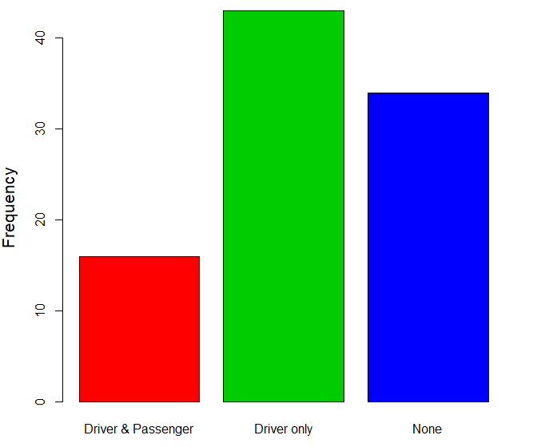
Bar Graphs
A bar graph is a graphical representation of a frequency distribution.
One bar is displayed for each category, and the height of each bar is the frequency (count) or relative frequency (proportion) in each category.
The width of the bars has no meaning.
> barplot(table(Cars93$AirBags),ylab="Frequency",cex.lab=1.3,col=c(2,3,4))
> barplot(table(Cars93$AirBags)/nrow(Cars93),ylab="Relative Frequency",
+ cex.lab=1.3,cex.names=1.2,col=c(2,3,4))

Slide 7
A Note on Colors
You will often want to add color to a graphic (lines, plotting characters, fill, …) and R has a large variety of color possibilities. As is often the case in R, there are multiple ways to specify colors.
The available built-in color names can be accessed with the colors function. Here are the first 20 (of 657)
> colors()[1:20]
[1] "white" "aliceblue" "antiquewhite" "antiquewhite1" "antiquewhite2"
[6] "antiquewhite3" "antiquewhite4" "aquamarine" "aquamarine1" "aquamarine2"
[11] "aquamarine3" "aquamarine4" "azure" "azure1" "azure2"
[16] "azure3" "azure4" "beige" "bisque" "bisque1"
The color palette tells R which color name is referred to by a specific integer. It can be viewed using the palette function.
> palette()
[1] "black" "red" "green3" "blue" "cyan" "magenta" "yellow" "gray"
This shows that in the current palette (the default) 1 indicates black, 2 gives red, 3 gives green3, 4 gives blue, etc.

Slide 8
A Note on Colors
You can also set the palette with the palette command.
> palette(c("red2","orchid1","yellow4","tomato2"))
> palette()
[1] "red2" "orchid1" "yellow4" "tomato2"
The color palette now assigns 1 to red2, 2 to orchid1, 3 to yellow4, etc. We can restore the default at any time using
> palette(“default”)
> palette()
[1] "black" "red" "green3" "blue" "cyan" "magenta" "yellow" "gray"
When setting the col parameter, either use the color names (with quotes around them) or first set the palette and then use the mapped integers.
Additional colors in R can be created using primitives rgb, hsv, and hcl or the derived rainbow, and heat.color.

Slide 9
Bar Graphs
A bar graph is called a Pareto Chart if it is constructed with the categories presented in order of frequency or relative frequency with the largest value to the left.
This can be used to highlight important issues
Example: The following is a Pareto chart for the reasons given for missing my Single Variable Calculus class last semester.
> barplot(sort(table(Reason)/length(Reason),decreasing=T),ylab="Relative Frequency",
+ xlab="Reason",col="lightblue",cex.names=1.2,cex.axis=1.2,cex.lab=1.2)
> box()
The function box draws a box around the current plot

Slide 10
Bar Graphs
To compare two bar graphs with the same categories, we can construct a side-by-side bar graph.
Example: The following side-by-side bar graph shows the reasons given for missing my Single Variable Calculus class during the spring and fall semesters last academic year.

Slide 11
Example
We can obtain the two-way frequency table of Airbags by Origin using:
> table(Cars93$AirBags,Cars93$Origin)
USA non-USA
Driver & Passenger 9 7
Driver only 23 20
None 16 18
> barplot(table(Cars93$AirBags,Cars93$Origin),col=c(2,3,4),beside=T,
+ ylim=c(0,30), cex.axis=1.2)
> legend(x=5,y=30,title="Airbags",legend=sort(unique(Cars93$AirBags)),
+ fill=c(2,3,4))
The script above provides the figure to the right depicting the AirBags variable as a function of the Origin variable.

Slide 12
Pie Charts
A pie chart is a graphical method for displaying the distribution of a qualitative variable.
The circle or pie represents the whole (all the units). The pie is divided into slices, one for each category of the qualitative variable.
> pie(table(Cars93$AirBags),main="Standard Air Bags",col=c(2,3,4),cex=1.3)
Note that the eye is good at judging linear measures and bad at judging relative areas. A bar chart or is often a preferable way of displaying this type of data.

